Slide 1
PathwayU An Introduction
Presented by The Center for Career and Talent Development

Slide 2
https://vimeo.com/322101731

Slide 3
What is it?
PathwayU is an online platform which provides you with the opportunity to analyze your unique talents
and skills while receiving valuable guidance in discovering your purpose and finding meaningful career success.
Guides you towards your purpose by helping you make critical training, education and career choices leading you to academic success.
Enhances your self-awareness by providing insight on your interests and the skills that align with your purpose.
Gives you a more meaningful life as a result from knowing your education and career paths.
Connects you to jobs based on your purpose by establishing your fit in a career with real employers.

Slide 4
Use the following link to access PathwayU
https://radford.pathwayu.com/

Slide 5
Click “Join Now” to create an account!

Slide 6
Fill out your account information and click “Find your Calling”

Slide 7
Go to your email and confirm your account
Simply click “Confirm Your Email”
*Remember to check your spam folder!

Slide 8
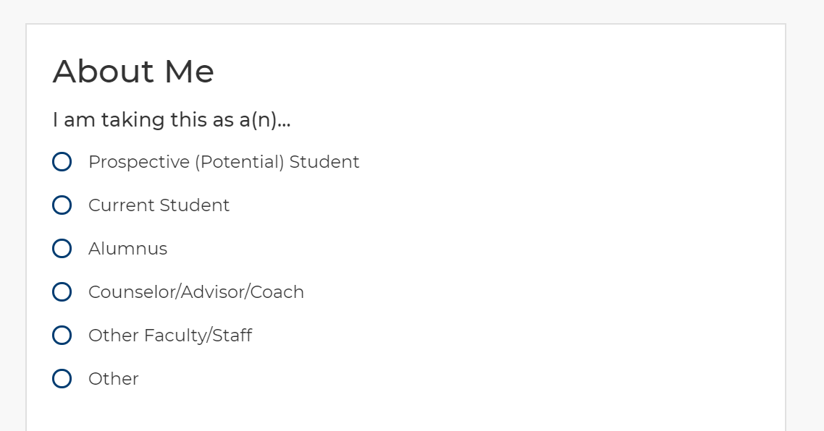
Begin the Pre-Assesment Survey
gg
Work through the pre-assessment survey.
Work through the “My Purpose” survey

Slide 9
Navigate the PathwayU Main Page
Begin your first assessment by clicking “Start Assessments”.
Set up your first appointment with a Career Counselor.

Slide 10
Read and Click through Introductory Assessment Slides
Click through the introductory screens
Make note of the special instructions prior to starting the assessment.

Slide 11
Work through each page of the assessment

Slide 12
View your Assessment Results
Observe your primary features and take note of the your results.
Then, take the next assessment in the list (There are a total of 4).

Slide 13
View your Career Matches
Following the final assessment, view the career matches PathwayU provides.
Use the “filter” tool on the left-hand side to narrow your subject area search.

Slide 14
View individual career areas and jobs.
View more details about individual positions and career areas, including the job forecast and average salaries.
‘Favorite’ the positions you find the most appealing to save them to view later.

Slide 15
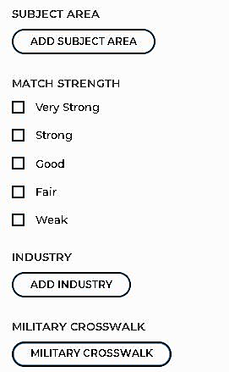
The Military Crosswalk
For prior service/currently enlisted students, a helpful function on the left hand side of the screen (with filters) gives you the option to view potential positions that may fit with your service-related job/responsibility.
Follow the link “Military Crosswalk” and input your information in the search bar.
The site will provide similar career options in the following page.

Slide 16
Search the “Job Board” function.
Find positions of interest within your ‘job match’ within either Handshake or Indeed
Click “Learn More” to find the job description and how to apply/follow-up.

Slide 17
Use the “Tools” menu
View the “Tools” menu to find different resources that can improve your job-search capabilities.
Update and manage your resume.
Learn about and build cover letters.
Find more information on your personal network.
Explore more exercises to help you find a career match!

Slide 18
Schedule an Appointment with your Career Coach
Continue to update and re-evaluate your career interests and options!
Make an appointment with your Career Coach for further guidance and help building your resume or LinkedIn account!
Schedule an appointment here:
https://www.radford.edu/content/career-services/home/about.html

