Slide 1
Electronic Personnel Action Forms
Presented by the
Department of Human Resources
February 2015

Slide 2
What is an EPAF?
Streamlined method for composing, submitting, and approving personnel actions electronically
EPAFs are a function of Banner that is accessed in Self-Service Banner (SSB).
EPAF has replaced the PR-4(Separation Transfer Notice) completely. And is in the process of replacing many personnel actions on the PR-40(Personnel Action)
EPAFS are another step in achieving a paperless personnel action process that supports the “GREEN” initiatives of the RU Campus Sustainability Policy.

Slide 3
Why Use EPAFs?
EPAFs are more efficient than manually completing and signing forms.
No “lost” paperwork or “hunting” for forms – you know where an EPAF is “sitting” at all times.
Reduced time it takes to get personnel actions approved and updated in Banner
The risk of data entry and transcription errors will be substantially decreased.

Slide 4
Actions Available in EPAF
Phase I(implemented) | Phase II(in process)
Job Terminations- FullTime & PartTime | Department Change
Supervisor Change | Department & Budget/FOAP Change
Job Title Change | Budget/FOAP Change
Transfer to another Department | Grant Continuation without Budget/FOAP Change
 | Grant Continuation with Budget/FOAP Change
 | Wage continuation
 | Hourly Rate Change

Slide 5
Department Change
A position that has a department (home org number) change.
Budget/FOAP does not change.
The home org number change is still within the same departmental hierarchy.
This is not to be confused with a transfer to another department.

Slide 6
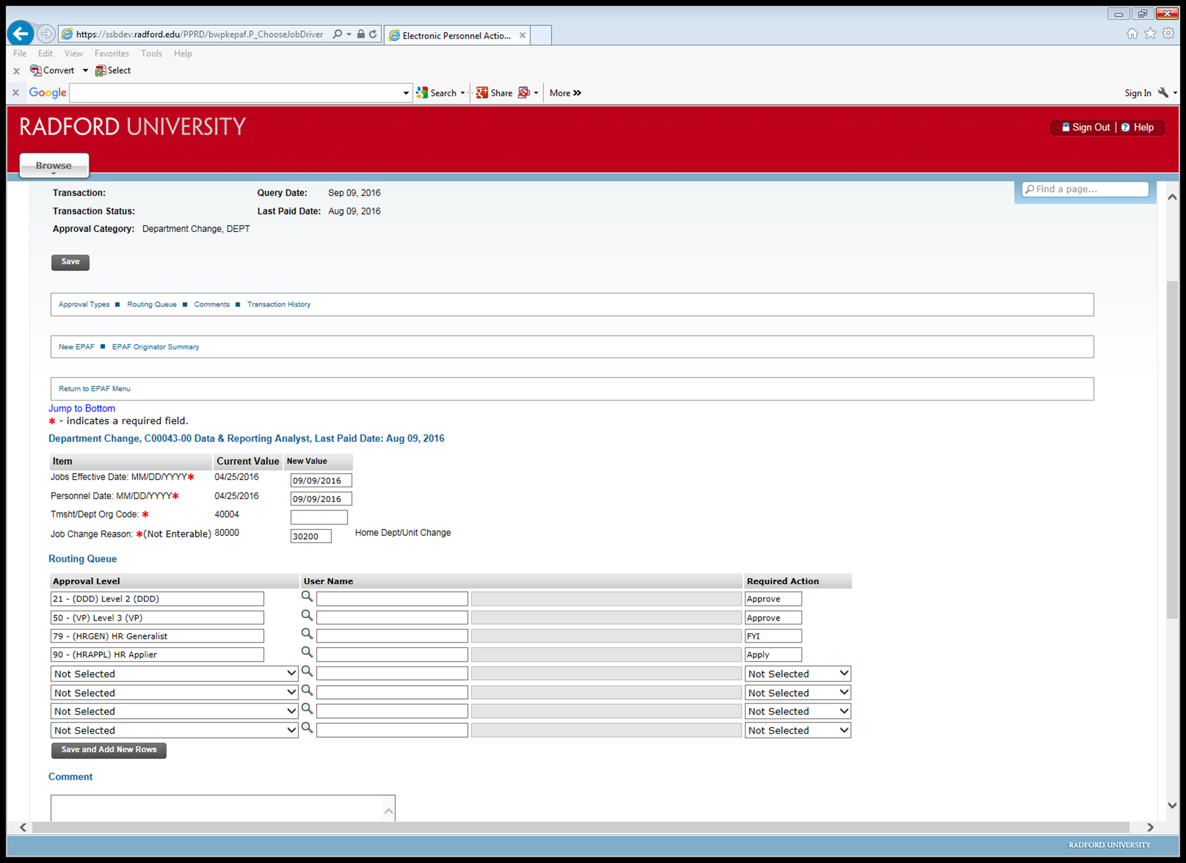
Department Change

Slide 7
Department & Budget FOAP Change
A position that has a department (home org number) change.
Budget/FOAP also changes.
The home org number change is still within the same departmental hierarchy.
This is not to be confused with a transfer to another department.

Slide 8
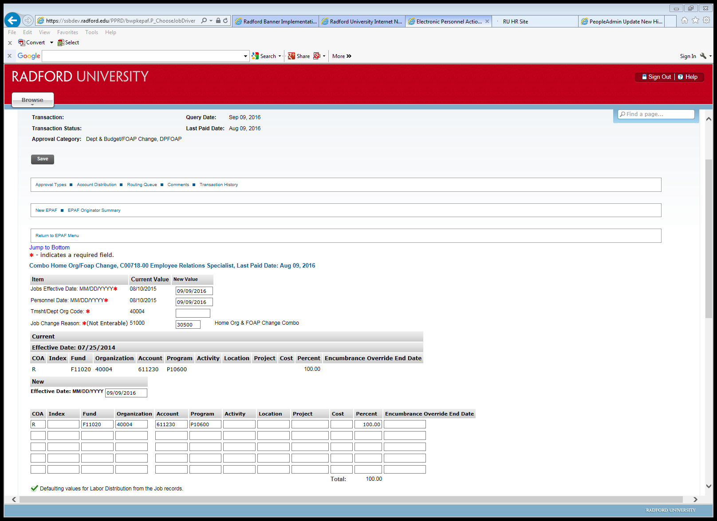
Department & Budget/ FOAP Change

Slide 9
Budget FOAP Change
Any regularly-funded (not grant) position that has a funding change in the Budget/FOAP.

Slide 10
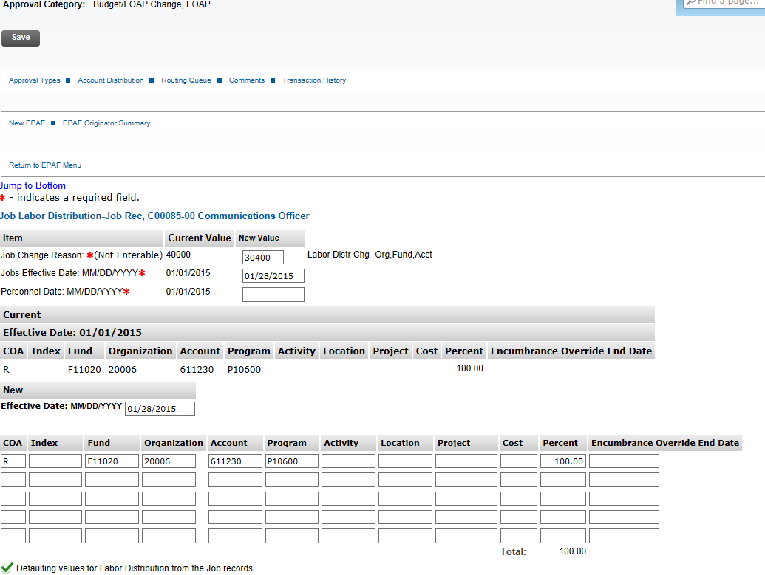
Budget/FOAP Change

Slide 11
Grant Continuation without Budget/FOAP Change
Grant-funded positions have end dates on them when the funding runs out.
When the funding is there to continue the position, a grant continuation must be done in order to continue the position.
This EPAF is done when the grant is continued for a specified time period but the funding (Budget/FOAP) stays the same.

Slide 12
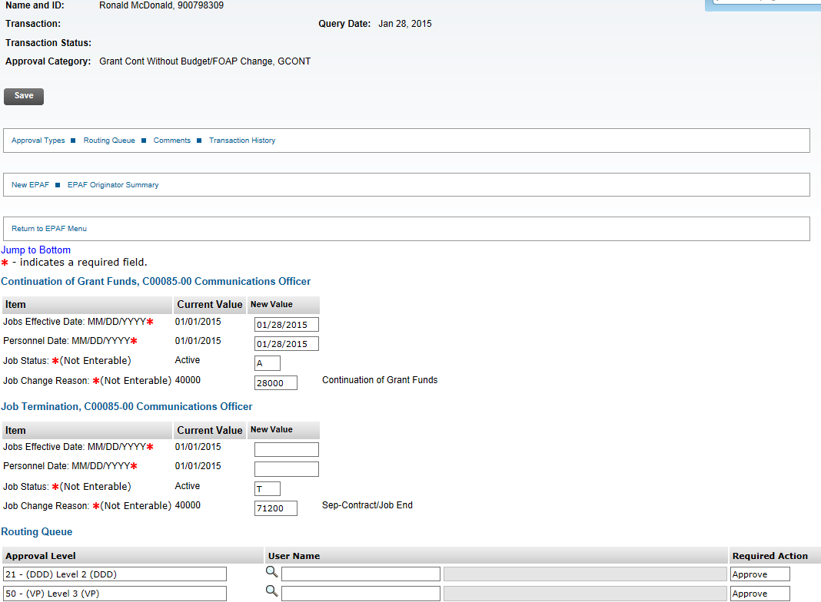
Grant Continuation without Budget/FOAP Change

Slide 13
Grant Continuation with Budget/FOAP Change
Grant-funded positions have end dates on them when the funding runs out.
When the funding is there to continue the position, a grant continuation must be done in order to continue the position.
This EPAF is done when the grant is continued for a specified time period and the funding (Budget/FOAP) also changes.

Slide 14
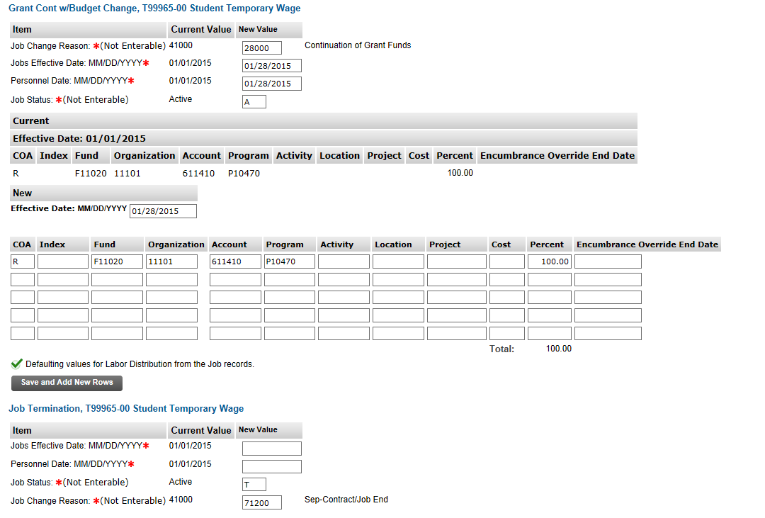
Grant Continuation with Budget/FOAP Change

Slide 15
Wage Continuation
Wage positions are approved for the fiscal year only.
Each year a wage continuation needs to be done to continue the position into the next year.

Slide 16
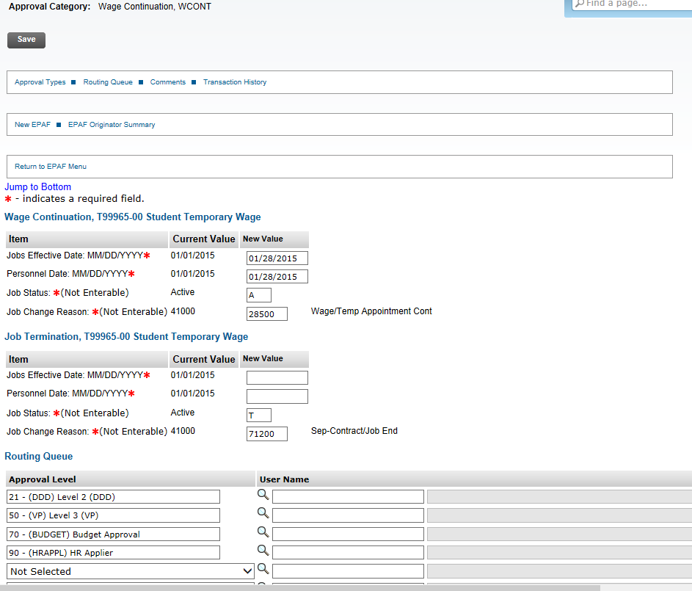
Wage Continuation

Slide 17
Hourly Rate Change
An hourly (wage) position that has a pay change.

Slide 18
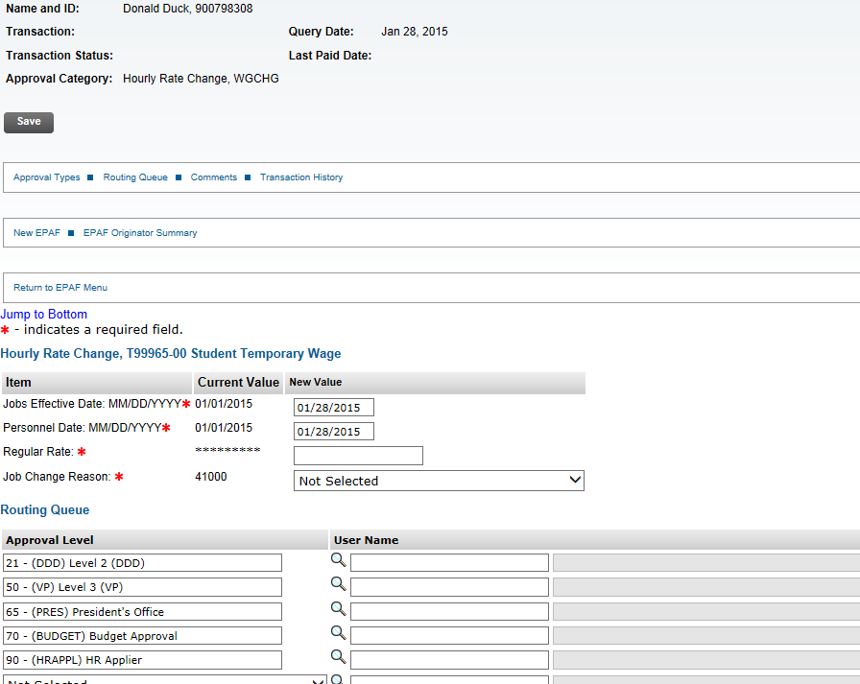
Hourly Rate Change

Slide 19
What are EPAF roles?
Roles are used to grant permission to users to either create or approve EPAFs:
Originator – the person who creates an EPAF
Approver – someone who electronically agrees (or disagrees) with an EPAF transaction
Proxy Approver – someone who has been delegated proxy access by an approver and has the same authority as the approver in making decisions on personnel transactions
FYI (For Your Information) – someone who only views the details of an EPAF transaction
Applier – an HR user who applies the EPAF transaction data to Banner

Slide 20
What are the Approver Levels?
Levels of authorization that an EPAF must go through in order to be completed
Five levels are assigned outside of HR:
Level 2: Dean, Director, Department/Division Head (DDD)
Level 3: Vice President (VP)
President
Sponsored Programs
Budget
Each EPAF has a mandatory routing queue with one or more of these levels assigned.

Slide 21
HR Generalists, by Departments
Carmella Carter - Academic Affairs Colleges/ 11xxx – 117xx
Larry Ashby – Academic Affairs Operational offices/118xx-12xxx
Jackie Taylor - Finance & Administration / 2xxxx
Alicia Dials - Information Technology, President, Student Affairs, University Relations and Advancement / 3xxxx, 4xxxx, 5xxxx, 6xxxx, 7xxxx

Slide 22
HR Approver and HR Applier
Kelly Griffith - Employees whose last name begins with A-G
Ramona Isaacs - Employees whose last name begins with H-N
Ann Owens - Employees whose last name begins with O-Z

Slide 23
Approval Levels
TYPE OF EPAF | Description | MANDATORY APPROVAL LEVELS |  |  |  |  |  | PAYROLL (Created After Applied) | BUDGET (Created After Applied)
 |  | DDD - Level 2 | VP - Level 3 | Spons. Pgms | Budget | HR Generalist | HR Applier
DEPT | Dept Change | X | X |  |  | FYI | APPLY
DPFOAP | Dept & Budget/FOAP Change | X | X |  | X | FYI | APPLY | FYI | FYI
FOAP | Budget/FOAP Change | X | X |  | X |  | APPLY | FYI | FYI
GCONT | Grant Cont Without Budget/FOAP Change | X | X | X | X | FYI | APPLY | FYI | FYI
GCONT2 | Grant Cont and Budget/FOAP Change | X | X | X | X | FYI | APPLY | FYI | FYI
WCONT | Wage Continuation | X | X |  | X |  | APPLY | FYI | FYI
WGCHG | Hourly Rate Change | X | X |  | X |  | APPLY | FYI | FYI

Slide 24
Important Reminders
For every EPAF, add FOAP in the comments section
Always SAVE and SUBMIT an EPAF
Effective Date and Personnel Date must always be the same(unless it is a late entry)
Set up default routing queue for every EPAF

Slide 25
What Cannot Be Done on EPAFs?
You cannot hire and rehire employees -
Hiring actions are still processed through PeopleAdmin or on a PR-40.
You cannot create or update employee positions.

Slide 26
Need More Information or Help?
Refer to the Instructions for EPAF Users document on the Training page of the Human Resources website
http://www.radford.edu/content/human-resources/home/training/EPAFs.html
Call Human Resources at extension 5008

Slide 27
QUESTIONS?

